Slide 1

Car Price Predictor
USING DATA ANALYSIS

Slide 2
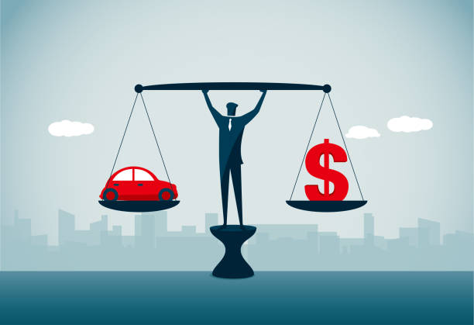
Team Detail
NAME
Himanshu Singh
Mukund Maheshwari
Parul Singh
SECTION
A
C
B
B.TECH CSE SEMESTER 6th
Notes:
Notes to presenter:
What is your purpose for sharing this reflection?
Is it at the end of a unit or project?
Are you sharing this reflection, at the attainment of a learning goal you set for yourself?
Is it at the end of a course?
State your purpose for the reflection or even the purpose of the learning experience or learning goal. Be clear and be specific in stating your purpose.

Slide 3

Prices of cars depends on
4
Owner
Fuel Type
3
2
Seller Type
1
Transmission
Notes:
Notes to presenter:
What steps will you be taking as a result of this learning experience?
Did you learn from any failed experiences? How will you do things differently?
What advice will you give to others so they can learn from your experiences?
How can you share what you learned with a real-world audience?
Some examples of next steps might be:
After delivering my first persuasive presentation, I am thinking about joining the debate team.
After making my first film, I’m considering entering it in our school film festival or local film festival.
After connecting with this career expert, I’d like to do some research on that career field because it sounds interesting to me.
This SmartArt allows you add images and text to help outline your process. If a picture is worth a thousand words, then pictures and words should help you communicate this reflection on learning perfectly! You can always click on Insert>SmartArt to change this graphic or select the graphic and click on the Design contextual menu to change the colors.
Feel free to use more than one slide to share your next steps. It also helps to add some video content to explain your message.

Slide 4

Things used in Development
Data Analysis
Predictions
HTML
CSS
Python
Machine Learning
Notes:
Notes to presenter:
Description of what you learned in your own words on one side.
Include information about the topic
Details about the topic will also be helpful here.
Tell the story of your learning experience. Just like a story there should always be a beginning, middle and an end.
On the other side, you can add a graphic that provides evidence of what you learned.
Feel free to use more than one slide to reflect upon your process. It also helps to add some video of your process.

Slide 5
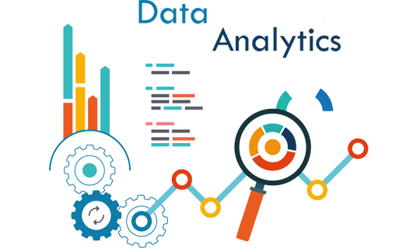
Data Analysis
Data analysis is the process of collecting, modeling, and analyzing data to extract insights that support decision-making. There are several methods and techniques to perform analysis depending on the industry and the aim of the investigation.

Slide 6
Steps for Data Analysis
Identifying the problem
Identify available data
Reading the concerned dataset
Data Understanding
Data Handling, Data Visualization, Data Preparation, Data Cleaning
Statistical Analysis
Splitting the data and features Scaling
Model Evaluation
Communicate Result

Slide 7
Major Features
RE-SALE PLATFORM
FEATURE SELECTION
A centralized platform for car resale that will predict prices of cars.
Feature based search and predictions.

Slide 8



Technology used
NUMPY -> It is a general purpose array processing package . It provides a high performance multi-dimensional array object and tools for working with these arrays.
SCIPY -> It is a free and open source Python library used for scientific computing and technical computing.
SCIKIT-LEARN -> It provides a range of supervised and unsupervised learning algorithms via a consistent interface in python.

Slide 9
PANDAS -> It is an open source library that is made mainly for working with relational or labelled data both easily and intuitively. It provides various data structures and operations for manipulating numerical data and time series.
PICKLE -> Python pickle module is used for serializing and de-serializing a Python object structure. Any object in Python can be picked so that it can be saved on disk.
MATPLOT -> It is an amazing library visualization library in Python for 2D plots of arrays. Matplotlib is a multi-platform data visualization library built by Numpy arrays and designed to work with the broader SciPy stack.

Slide 10
THANK YOU

